Slide 1
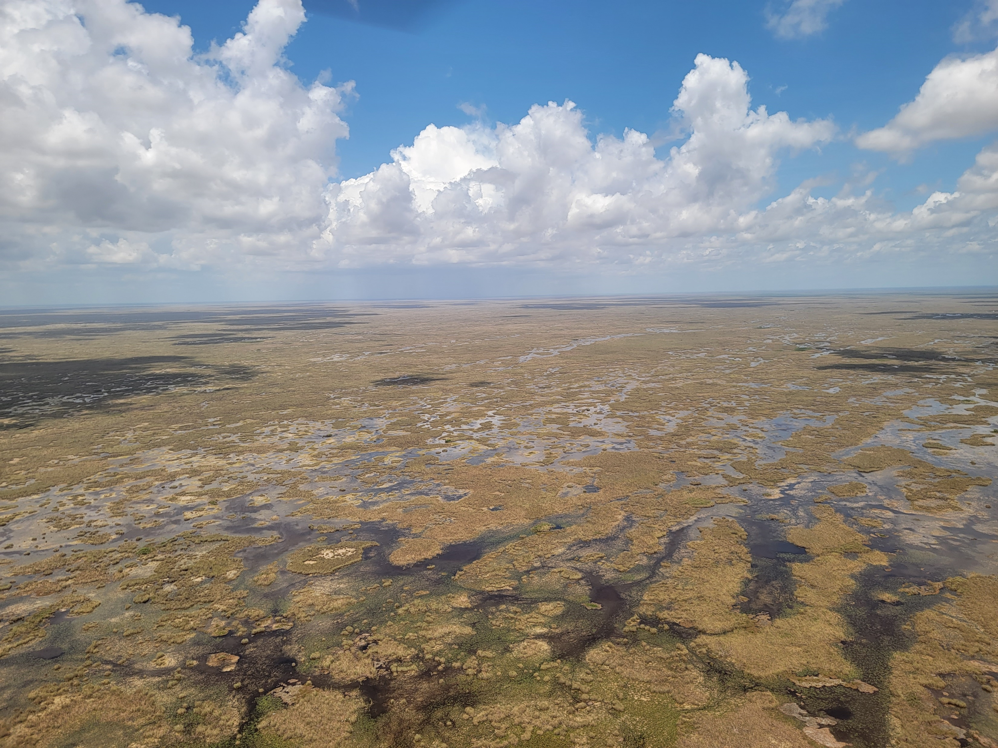
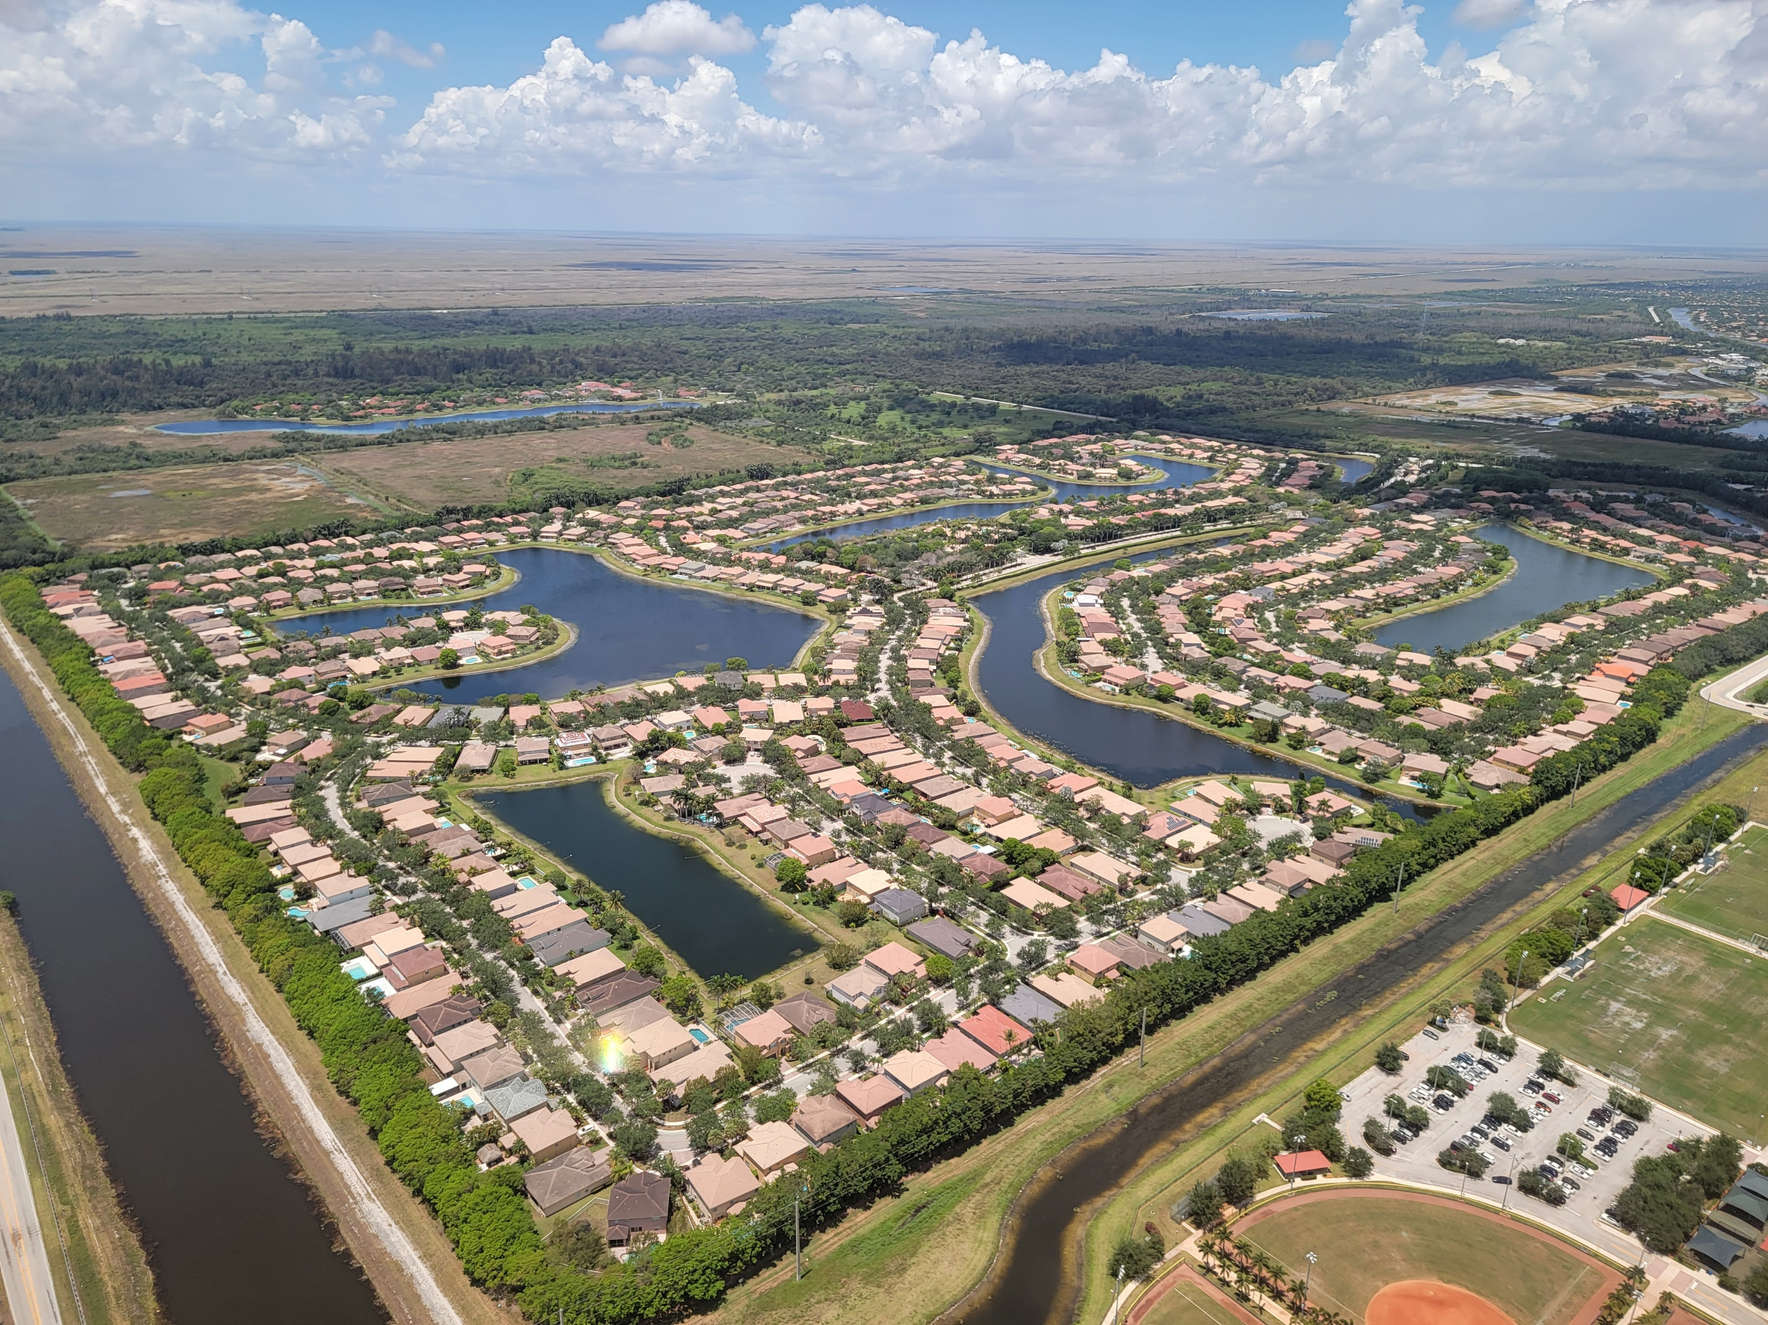
Natural Capital

Slide 2
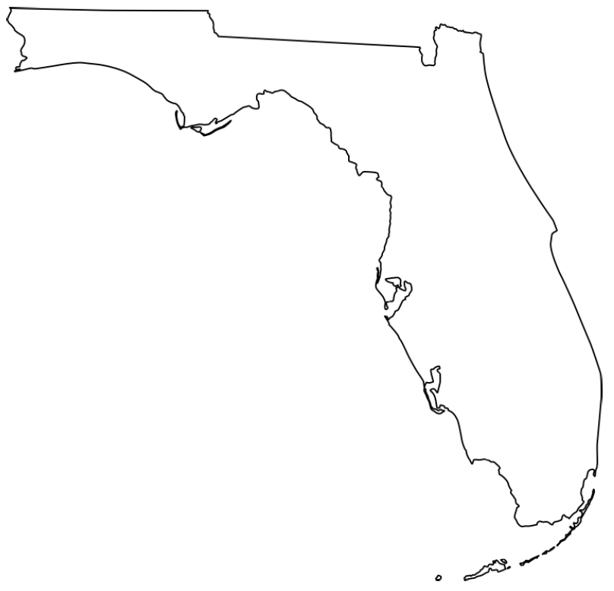
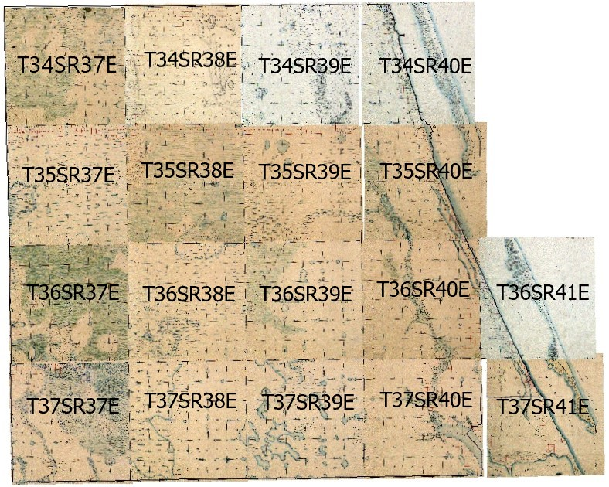
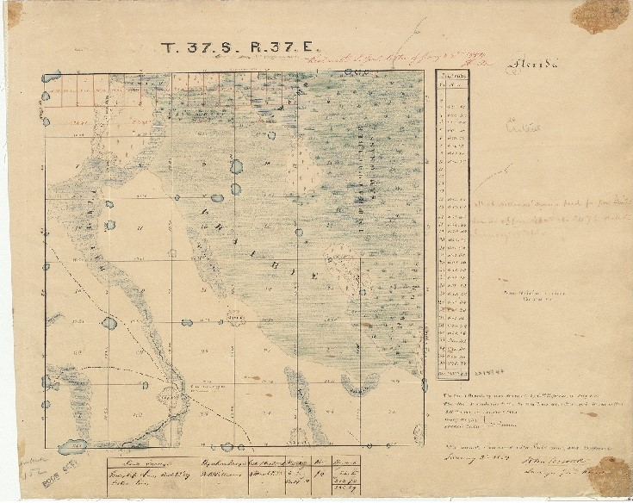
How Much Did We Have?
Lawlor et al. 2023

Slide 3
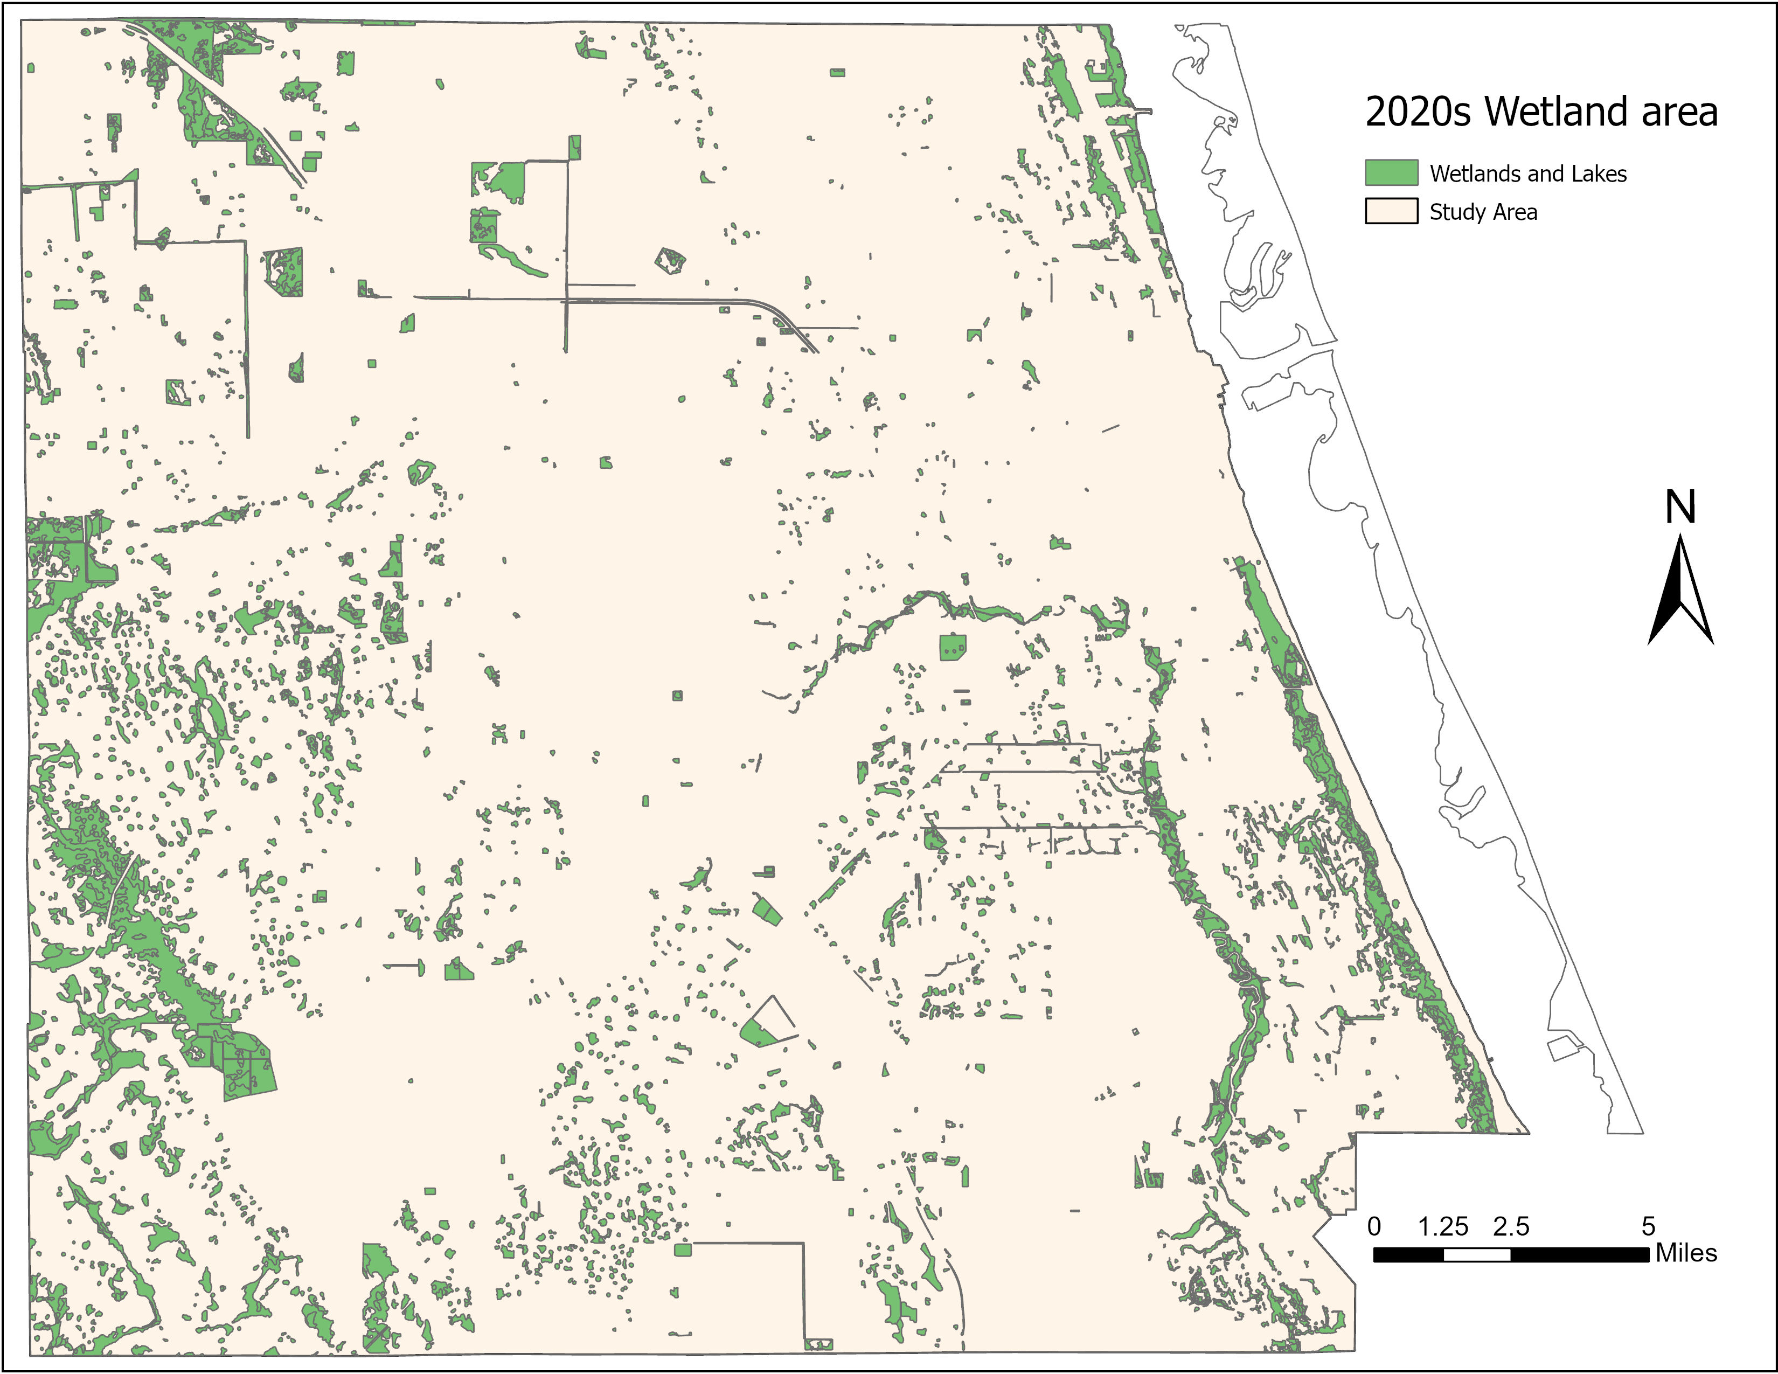
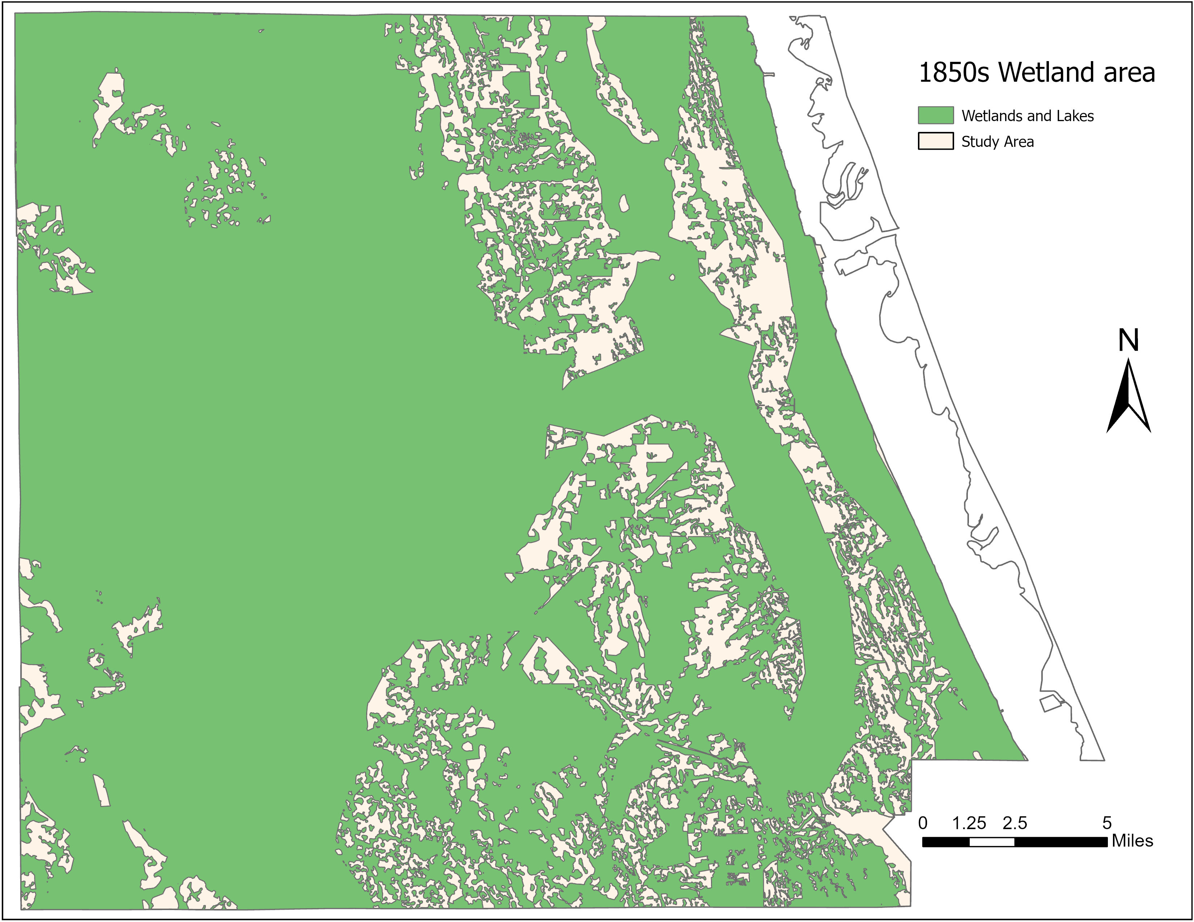
How Much Have We Lost?
Wetland loss >85% between the 1850s-2020s!!
Lawlor et al. 2023; K Rains et al. In Preparation

Slide 4
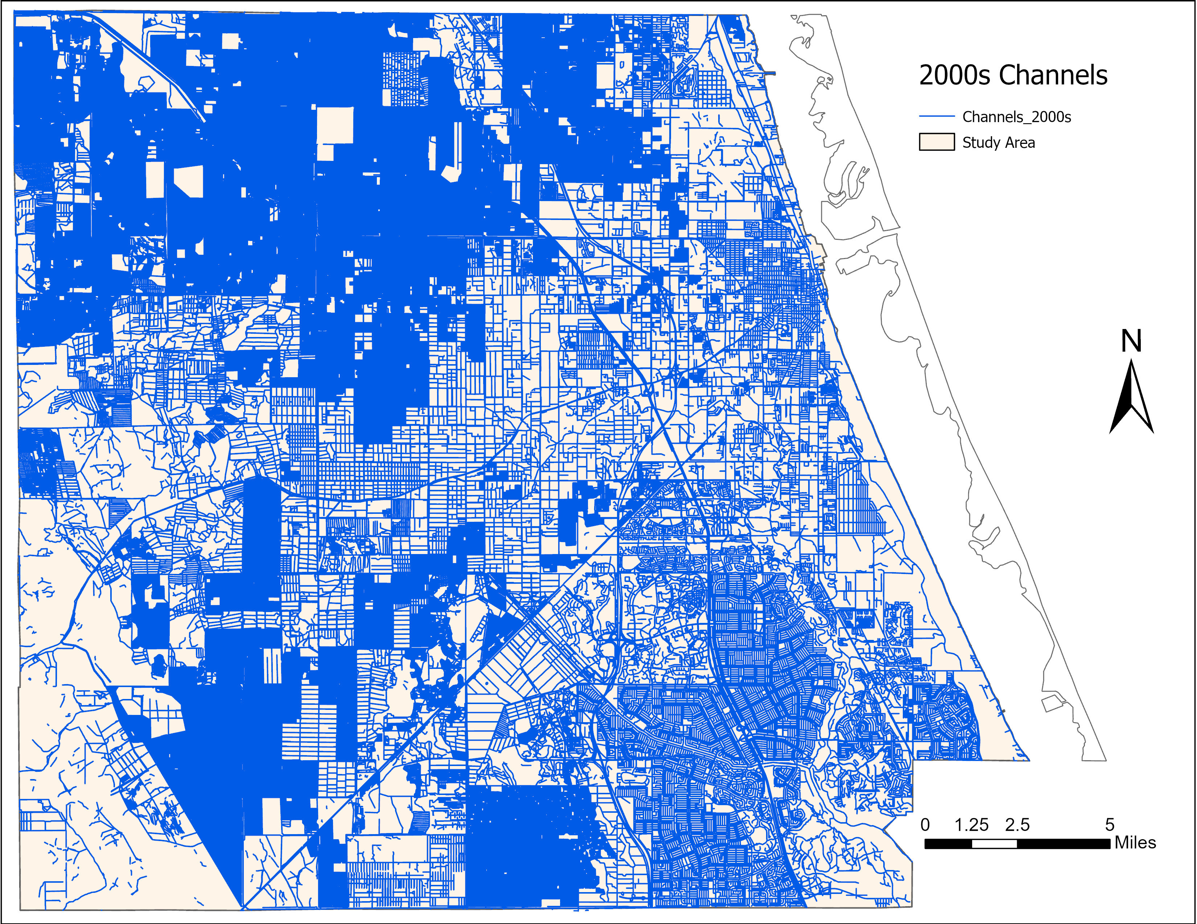
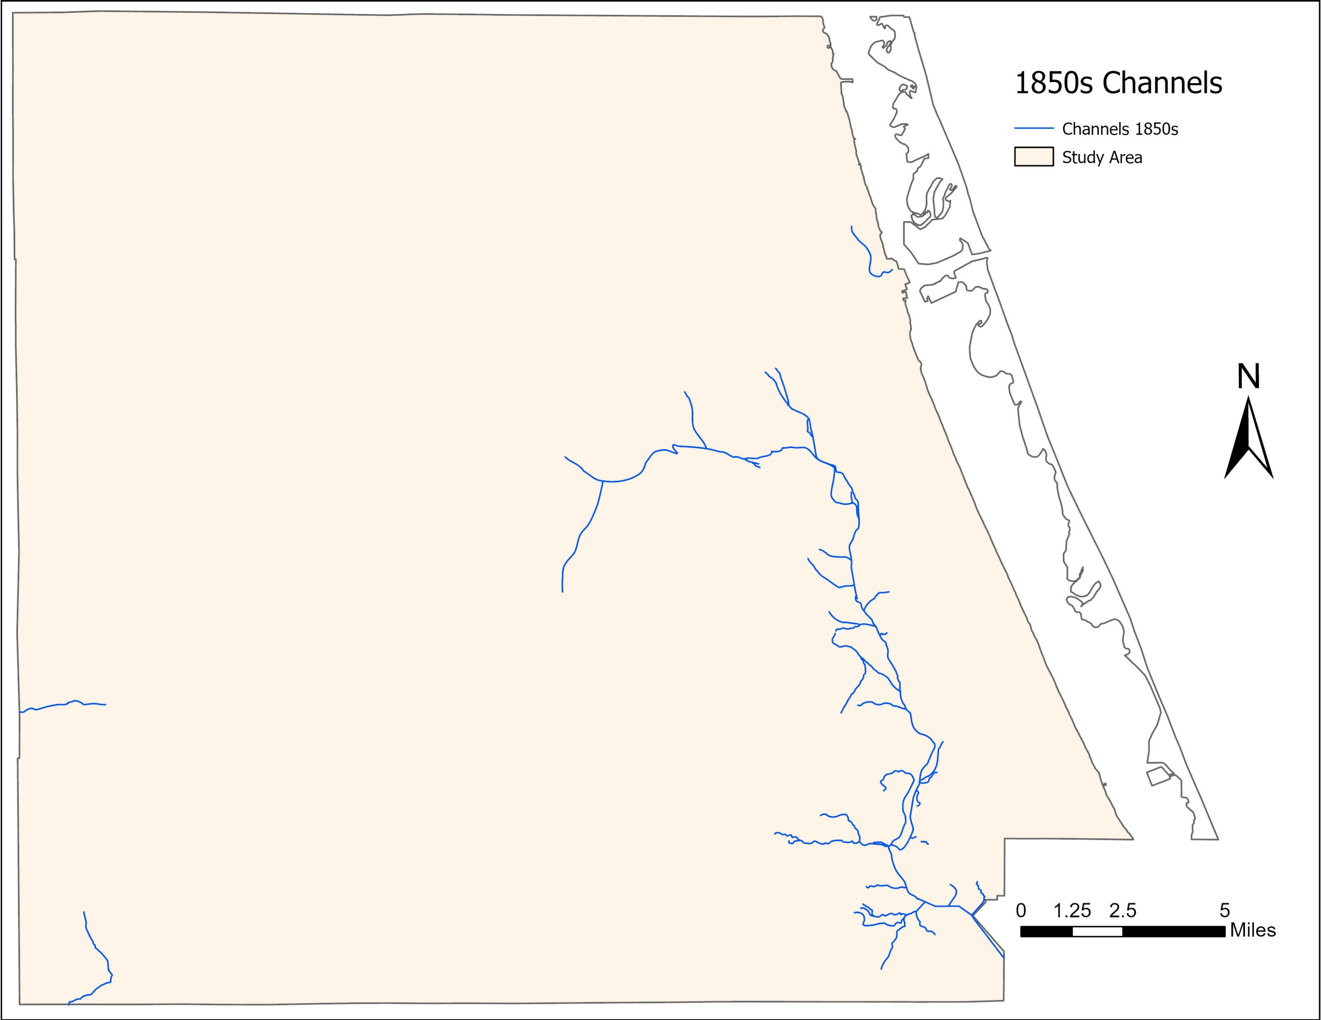
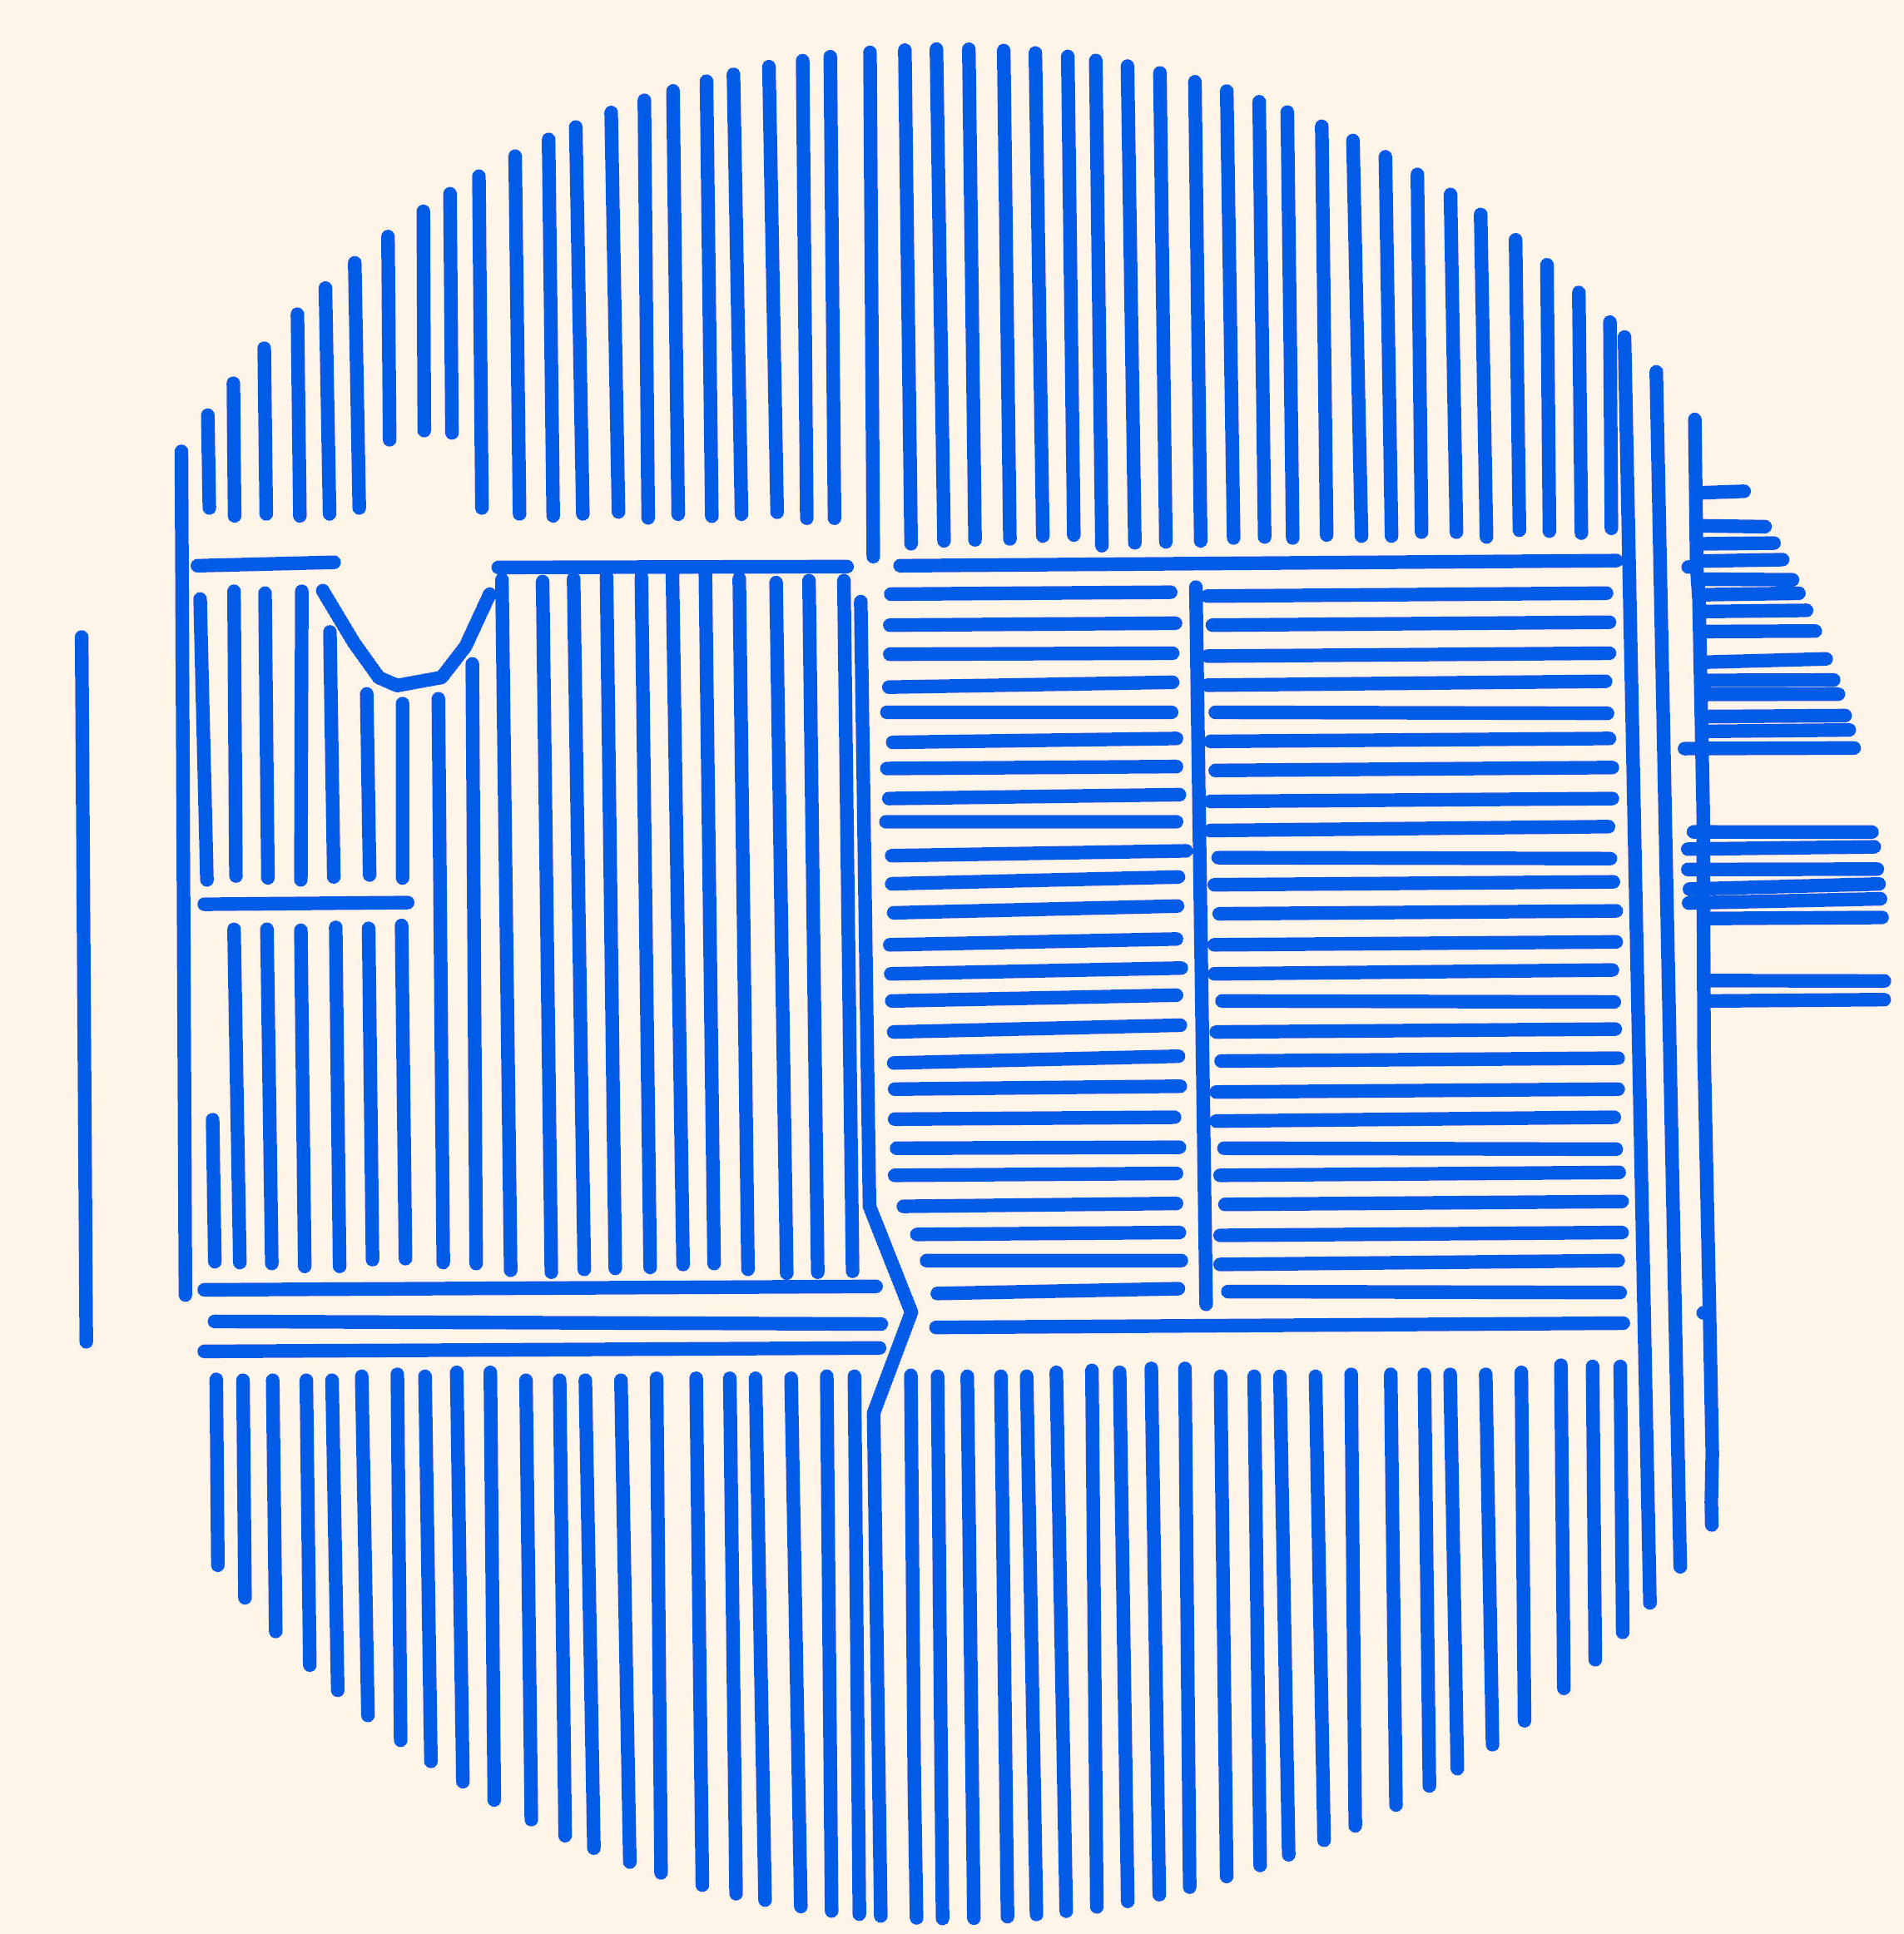
How Much Have We Lost?
Drainage density increased >300x between the 1850s-2000s!!
Lawlor et al. 2023, K Rains et al. In Preparation

Slide 5
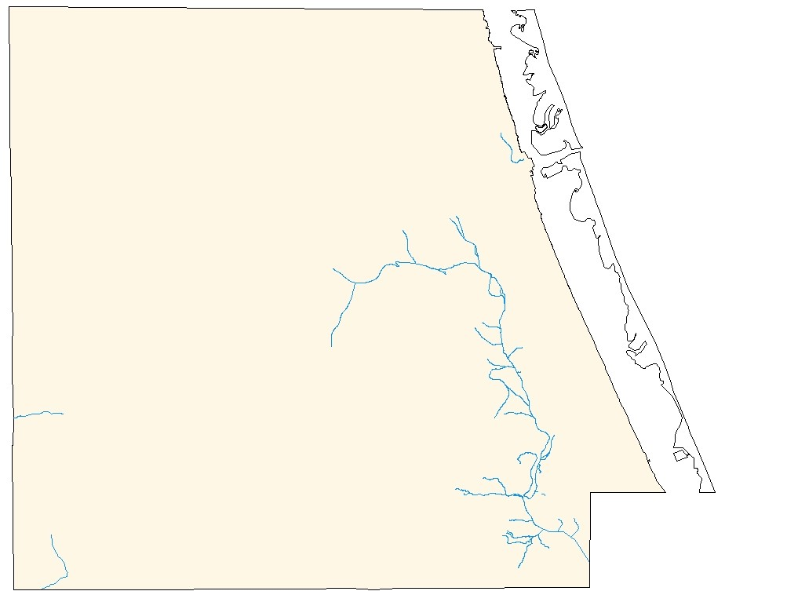
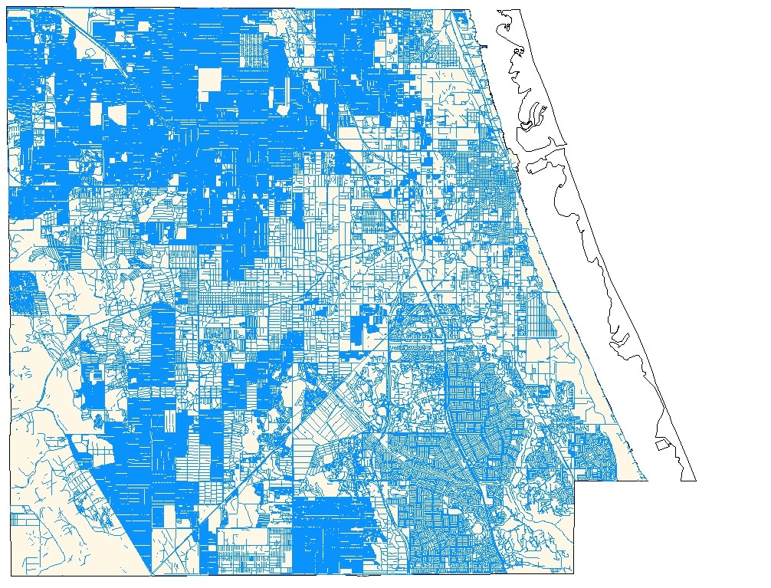
Lost Natural Capital, Lost Resilience
2% within 100m of a channel
85% of this wetland
85% within 100m of a channel
9% of this wetland
Lawlor et al. 2023, K Rains et al. In Preparation

