Slide 1
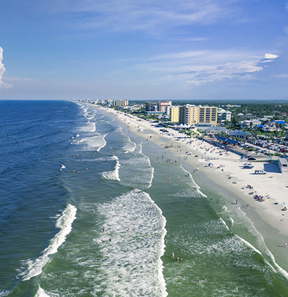
Improved Sea Level Rise Projections to Inform Statewide Resilience Efforts
Tom Frazer - tfrazer@usf.edu
Florida Ocean Alliance
Coastal resilience leadership meeting
November 9, 2023

Slide 2
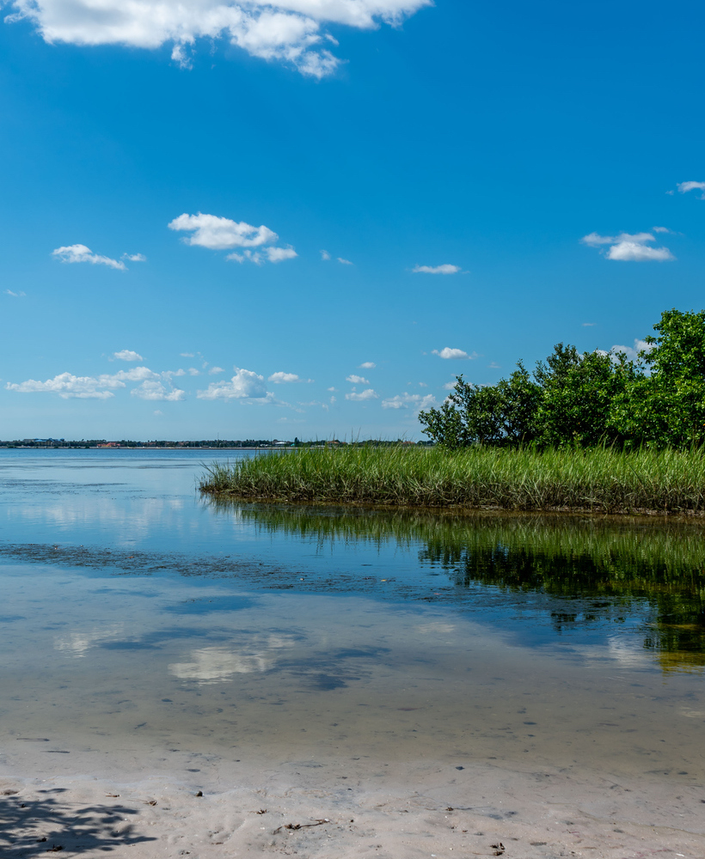
Florida Flood Hub
Overview
Represents a first in Florida
Established by the State at the University of South Florida College of Marine Science
Focuses on some of the state’s most pressing environmental challenges
Aims to improve flood forecasting and inform science-based policy, planning, and management
Bridges the gap between scientists, policymakers, practitioners, and the public to help communities mitigate and adapt to flooding risks
Interested in resilience — the ability of communities to prepare for, withstand, and rebound from flood events and other natural hazards

Slide 3
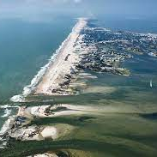
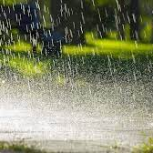

Scientific and Technical Workgroups
workgroups are central to the success of the Florida Flood hub
Sea Level Rise Workgroup
Rainfall Workgroup
Comprehensive Modeling Workgroup

Slide 4
Sea Level Rise Workgroup
Initial products
Use data in the Federal Task Force report released in 2022
Focus on sea level rise as it affects Florida
Combine the west and east coasts of Florida, which were separated in the federal report
Predict changes in sea level from a 2000 baseline for five different scenarios across three time horizons
Calculate the likelihood of sea level rise exceeding projected values

Slide 5
Sea Level Rise Projections for Florida
SEA LEVEL RISE WORKGROUP INITIAL PRODUCTS
Table 1: Sea Level Change Relative to 2000 for Florida Across Three Time Horizons
Sea Level Rise Projection | Time Horizon
 | 2000 – 2040 |  | 2000 – 2050 |  | 2000 – 2070
----------------------------- mm / inches ----------------------------- | mm / in
Low | 198 / 7.8 |  | 250 / 9.8 |  | 334 / 13.1
Int. Low | 227 / 8.9 |  | 292 / 11.5 |  | 423 / 16.7
Int. | 244 / 9.6 |  | 330 / 13.0 |  | 548 / 21.6
Int. High | 271 / 10.7 |  | 394 / 15.5 |  | 759 / 29.9
High | 296 / 11.7 |  | 454 / 17.9 |  | 966 / 38.0

Slide 6
Exceedance Probabilities
SEA LEVEL RISE WORKGROUP INITIAL PRODUCTS
Table 2: Exceedance Probabilities for Sea Level Rise Projections for Temperature Scenarios by 2100 from the Federal Task Force Report
Sea Level Rise Projection | Global Mean Surface Air Temperature Increase
 | 1.5°C | 2.0°C | 3.0°C |  |  | 4.0°C | 5.0°C
Low | 92% | 98% | 99% |  |  | >99% | >99%
Int. Low | 37% | 50% | 82% |  |  | 97% | >99%
Int. | <1% | 2% | 5% |  |  | 10% | 23%
Int. High | <1% | <1% | <1% |  |  | 1% | 2%
High | <1% | <1% | <1% |  |  | <1% | <1%

Slide 7
Exceedance Probabilities
SEA LEVEL RISE WORKGROUP INITIAL PRODUCTS
Table 2: Exceedance Probabilities for Sea Level Rise Projections for Temperature Scenarios by 2100 from the Federal Task Force Report
Sea Level Rise Projection | Global Mean Surface Air Temperature Increase
 | 1.5°C | 2.0°C | 3.0°C |  |  | 4.0°C | 5.0°C
Low | 92% | 98% | 99% |  |  | >99% | >99%
Int. Low | 37% | 50% | 82% |  |  | 97% | >99%
Intermediate | <1% | 2% | 5% |  |  | 10% | 23%
Int. High | <1% | <1% | <1% |  |  | 1% | 2%
High | <1% | <1% | <1% |  |  | <1% | <1%

Slide 8
Sea Level Rise Projections for Florida
SEA LEVEL RISE WORKGROUP INITIAL PRODUCTS
Table 1: Sea Level Change Relative to 2000 for Florida Across Three Time Horizons
Sea Level Rise Projection | Time Horizon
 | 2000 – 2040 |  | 2000 – 2050 |  | 2000 – 2070
----------------------------- mm / inches ----------------------------- | mm / in
Low | 198 / 7.8 |  | 250 / 9.8 |  | 334 / 13.1
Int. Low | 227 / 8.9 |  | 292 / 11.5 |  | 423 / 16.7
Int. | 244 / 9.6 |  | 330 / 13.0 |  | 548 / 21.6
Int. High | 271 / 10.7 |  | 394 / 15.5 |  | 759 / 29.9
High | 296 / 11.7 |  | 454 / 17.9 |  | 966 / 38.0

Slide 9
Sea Level Rise Projections for Florida
POTENTIAL APPLICATION: COMBINE LIKELY PROJECTION WITH PLANNING HORIZON TO ASSESS RISK
Examples:
Transportation (roads and bridges)
Energy systems (replacement and upgrades)
Stormwater (improved design)
Shoreline protection (green and gray)
Other critical assets

Slide 10
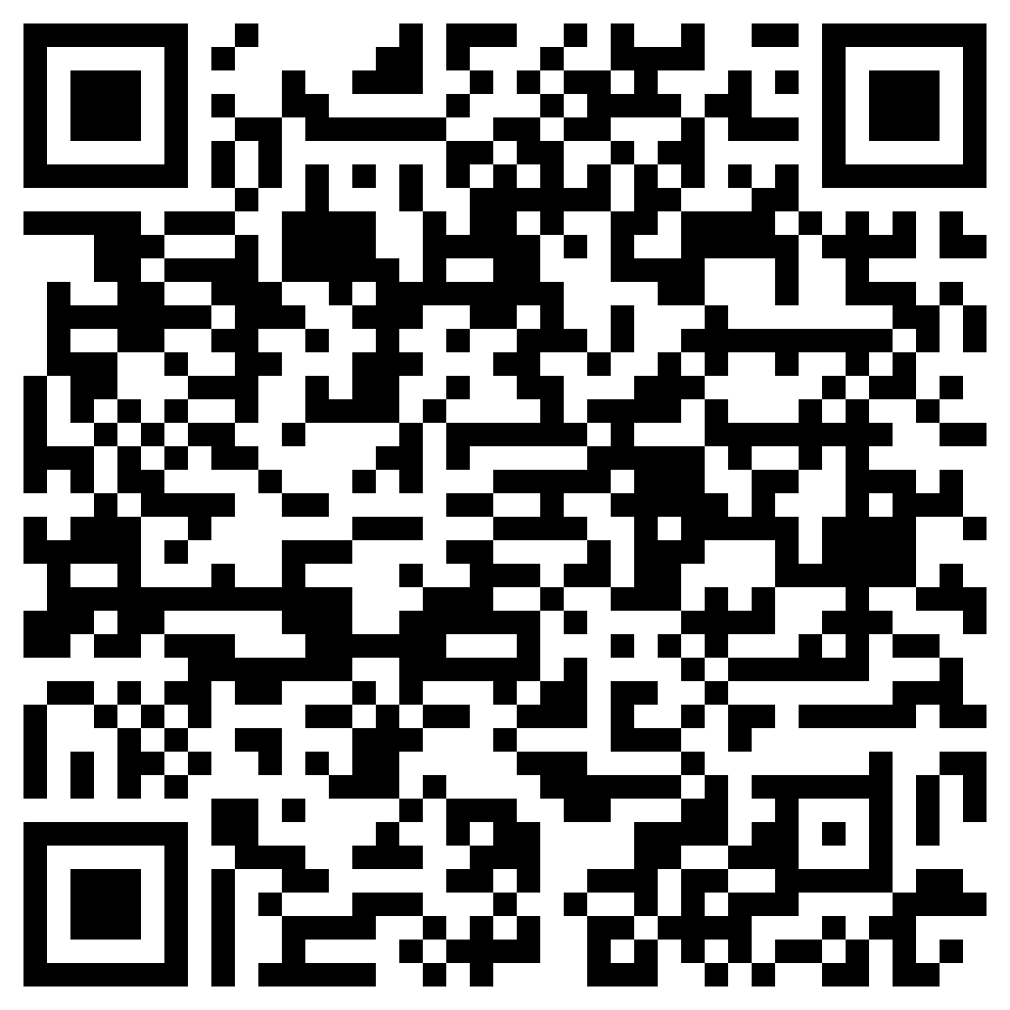
Sea Level Rise Projections for Florida
TECHNICAL REPORT AND SUMMARY FOR POLICYMAKERS

Slide 11
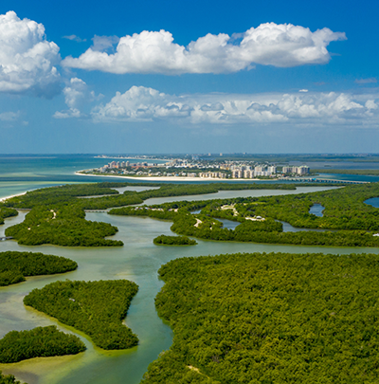
Tom Frazer tfrazer@usf.edu

